Slide 1
Programming Foundations: Introduction to Python
Chris Walshaw
Computing & Mathematical Sciences
University of Greenwich

Slide 2
Objectives
What is programming?
languages / syntax / problems
What is Python?
installing / IDLE / shell
Using the Python shell
First programs
Hello World!
other examples
Turtle graphics
getting started
simple shapes

Slide 3
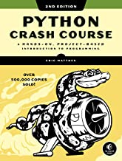
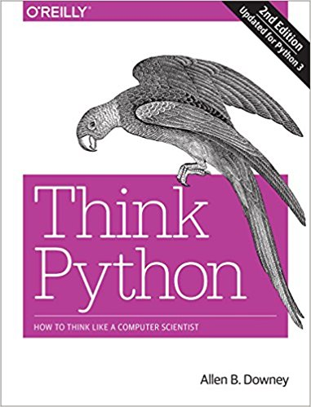
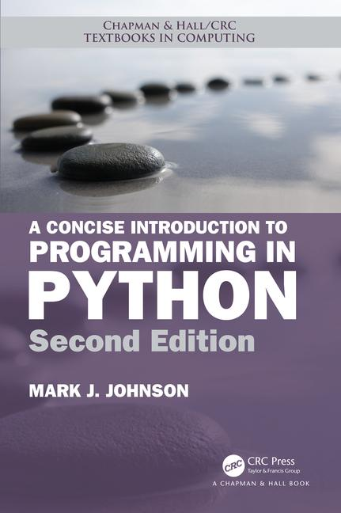
Suggested Textbooks
If you want a textbook to read, you could try one of these
Python Crash Course (2e): A Hands-On, Project-Based Introduction to Programming, Eric Matthes, No Starch Press
Think Python: How to think like a Computer Scientist (2e), Allen Downey, O’Reilly
downloadable pdf available for free(!) at https://greenteapress.com/wp/think-python-2e/
A Concise Introduction to Programming in Python, Mark Johnson, CRC Press
All 3 books are a good introduction to Python and go far beyond what we cover

Slide 4
What is computer programming?
Computer programming is the science (and art) of writing computer programs
Notice the confusing and illogical spelling
you study a degree programme (e.g. BSc Computing, BSc Business Information Technology, …)
or you might watch a TV programme
but you will be writing a computer program
when you do this, you will be programming (and not programing)

Slide 5
What is a computer program?
A computer program is a set of instructions that tell a computer what to do
everything a computer does is controlled by a program
Some well-known examples of programs:
A web browser (like Chrome, Safari or MS Edge) is a computer program that can be used to view web pages
An office suite (like Microsoft Office) is a collection of computer programs that can be used to write documents
A video game is a computer program
A cash machine (ATM) is controlled by a computer program
Computer programs are often referred to as code and programming is sometimes called coding
A computer program is written in a programming language

Slide 6
What is a programming language?
A programming language is a type of written language that tells computers what to do
There are many different programming languages: e.g. Java, JavaScript, C, C++, C#, Objective-C, Visual basic (VB), Python, …
Each language has its own keywords, grammar, punctuation and syntax
although several languages look quite similar (Java, JavaScript, C, C++, C#, …)

Slide 7
What is syntax?
Definition:
(generally) the arrangement of words and phrases to create well-formed sentences in a language
(more specifically) the structure of statements in a computer programming language
However,
in English the syntax is fairly flexible
the syntax is fairly flexible in English
the syntax in English is fairly flexible
in the English syntax is flexible fairly

Slide 8
Programming problems
In programming syntax is very strict
if you get it wrong, the computer won’t know what you mean
And sometimes in English too
computer get if it know mean the what won’t wrong you
This is why beginners sometimes find programming hard
they in the wrong order get the commands
and sum times they miss spelt the wurdz

Slide 9
What is Python (1)?
Python is a general-purpose programming language.
so you can use Python to write code for any pretty much any programming task
Large organizations that use Python include Wikipedia, Google, Yahoo!, CERN, NASA, Facebook, Amazon & Instagram.
Python is particularly popular for
scientific computing
data science
machine learning / artificial intelligence
natural language processing

Slide 10
What is Python (2)?
Python is an interpreted language rather than a compiled language
means that python code is translated and executed by another program (a Python interpreter) one statement at a time
In a compiled language, the entire source code is compiled and then executed altogether
that probably doesn’t mean anything currently, but later in your studies you will probably meet compiled languages (e.g. Java)

Slide 11
What is Python (3)?
Python is an object-oriented programming language
object-oriented programming is a powerful paradigm for developing reusable software
In Programming Foundations we will just cover the basics of programming
Later in Object-Oriented Programming we will cover much more about objects and classes

Slide 12
Installing Python
You can download and install Python from https://www.python.org/
versions for PCs, Macs & other platforms
It comes with its own development environment called IDLE
stands for Integrated Development and Learning Environment
includes smart code editor, the Python shell & an integrated debugger

Slide 13
Other options
You could also write Python in a simple text editor like NotePad (very basic) or NotePad++ (better) and run it from the Windows/MacOS command window
but why would you do that?
You can create an account at PythonAnywhere.com
this site allows you to create, edit and run Python programs from your web browser
your programs are stored in the cloud, so accessible from any web browser
There are other, more sophisticated, development environments
we will look at another one (PyCharm) later on

Slide 14
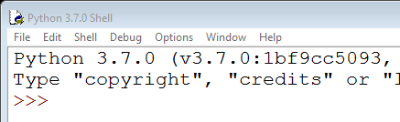
What is the Python shell?
The Python shell is the most basic way of interacting with Python
run it by starting up IDLE (Windows key > IDLE)
It provides a command prompt >>> where you can type in Python commands
You can also use it to run Python programs

Slide 15
First example
Every time a programmer starts with a new language it is traditional to write a very basic program to check that everything is configured correctly
Typically the first program just outputs the words “Hello world!”
In fact, in Python we don’t even need to write a program, we can just type Python commands directly into the shell
type the command at the prompt >>>

Slide 16
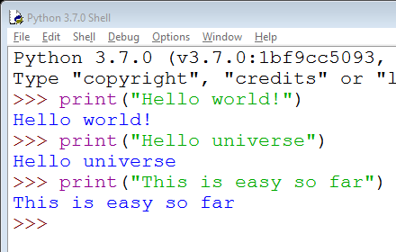
Hello world!

Slide 17
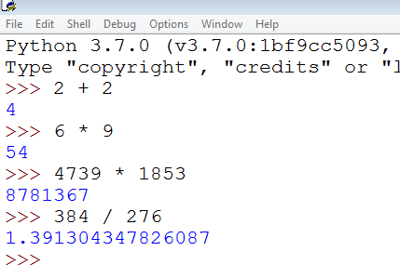
Calculator
You can also use the Python shell as a (quite advanced) calculator

Slide 18
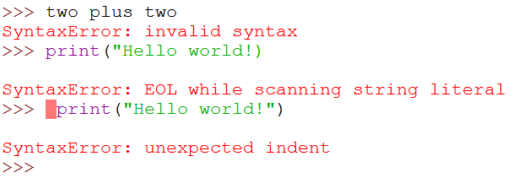
However …
… the Python shell only understands correctly written Python commands
Python can’t speak English
there’s only one double quote "
in Python, whitespace (blank spaces, tabs, etc) is meaningful … more details later

Slide 19
Saving your work
It is not very sophisticated to type Python directly into a shell
when you log off, all your work will be lost!
Instead you should will write your programs in Python (.py) files
But make sure you keep them organised
Programming Foundations alone will include over 100 examples

Slide 20
Python examples
Accompanying this presentation there is a zip file you can download
The zip file contains some .py files – these are Python programs!
Make sure you unzip it (e.g. right click > Extract All…)
if you just open them from within the zip file, they probably won’t work!

Slide 21
01HelloWorld.py
You can run the program by double clicking but it will just start up a shell, run the code and close the shell immediately
you will not be able to read what it says
we will fix this later
Instead open it in IDLE
start up IDLE, select File > Open… (Ctrl+O) and browse to the folder
alternatively right-click on the .py file and select “Edit with IDLE”
Run by selecting “Run > Run Module” or pressing F5

Slide 22
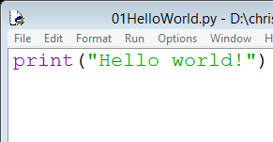
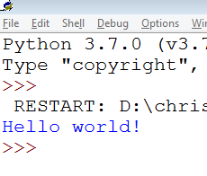
Open a file and run it (F5)
hit F5 or Run > Run Module

Slide 23
So far so good
But the Hello World program only ever does one thing ☹
the output never changes regardless of what the user does
There are a few more examples in the zip files to give a flavour of what else we will be able to achieve later on – demo
text analysis: Lorem examples
file management: File examples
pizzas: GUI example

Slide 24
Turtle graphics
We will now look at some basic examples using Turtle graphics
some of you are probably already familiar with Turtle
we won’t use it much, but it’s nice to start with something familiar (and don’t worry if you’re not a Turtle user)
The Turtle graphics module comes built in to Python and allows you to create some really intricate 2D graphics and games
IDLE even has a Turtle demo (“Help > Turtle Demo”), e.g.
bytedesign (fancy design)
sorting_animate (animated sorting algorithms)
wikipedia (fancy animated design, but only ~50 lines of code!)

Slide 25
Yin-Yang
Let’s copy the Yin-Yang demo into IDLE
to copy, click in the code window, hit Ctrl+A (select all) and Ctrl+C (copy)
then in IDLE hit Ctrl+N (new file) and Ctrl+V (paste)
these keyboard shortcuts should be familiar from other programs like Word – if they are not, get used to them – they will save you a LOT of time if you work regularly with computers
Now run it (F5)
IDLE will ask you to save the file first – choose a suitable name like yinyang

Slide 26
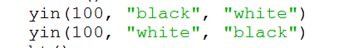
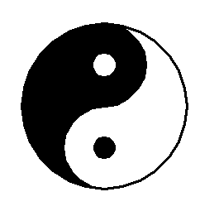
Modifying the code
We haven’t yet found out how Turtle works, but there are some easy changes we can make … what are they?
that’s right – the radius and the colours
Let’s change the radius from 200 to 100
and now to 50

Slide 27
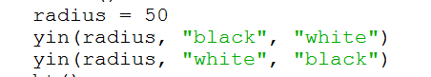
Modifying the code
Hmm … every time we want to do this we have to make two identical changes
if they are not identical it doesn’t work properly
How about if we stored the new value somewhere and then used it … like this
these values need to be identical

Slide 28
Variables
Now we only need to make one change (to radius)
no danger of forgetting to update the values everywhere (in a complicated program there maybe hundreds of places where a value is repeated)
In the original version the value 200 is hard-coded into the program
the value is fixed by the programmer and the output will always be the same every time the program is run
hard-coded values are fine but not if they are repeated many times – makes the program hard to maintain/debug/change
In our new version, radius is a variable
even though it doesn’t change when the program is run
Ideally the radius could be decided on by the user
perhaps using a slider or a text field to enter the value
Lots more about variables in the next topic

Slide 29
Turtle principles
Turtle programs can be very complex but are built of simple commands
Turtle works by moving a pen (called the turtle) around the screen
t.forward(100) – move forward 100 units
t.left(90) – turn left through 90°
And that’s enough to draw a square
see 08Turtle_square.py

Slide 30
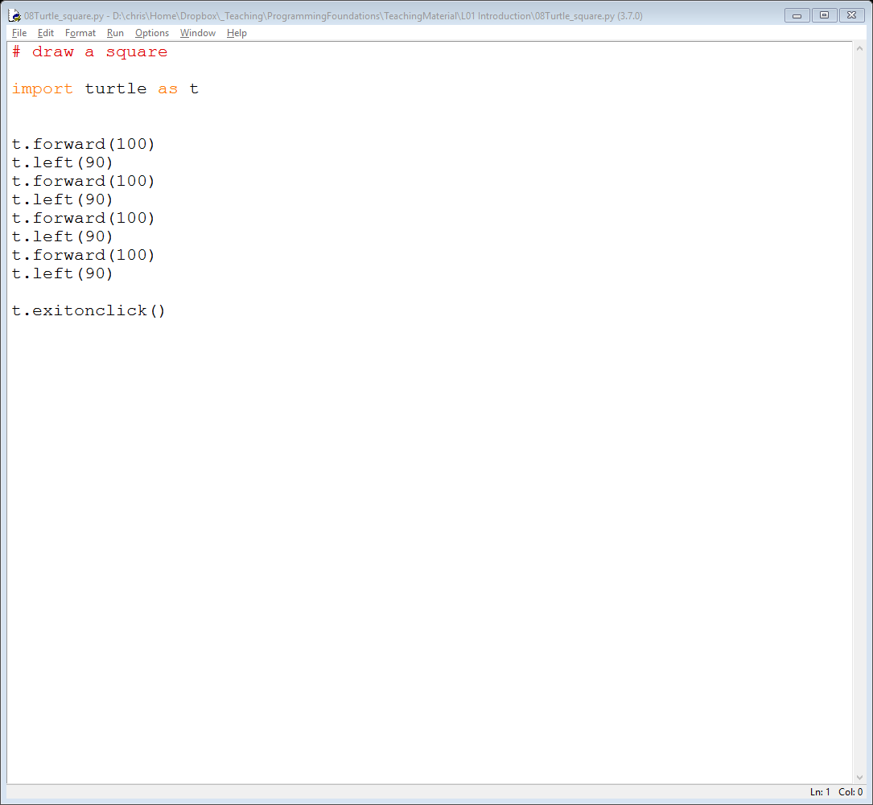
08Turtle_square
Here’s the code
draw a line, length 100
turn left (anti-clockwise) through 90⁰
draw a line, length 100
turn left (anti-clockwise) through 90⁰
and so on …

Slide 31
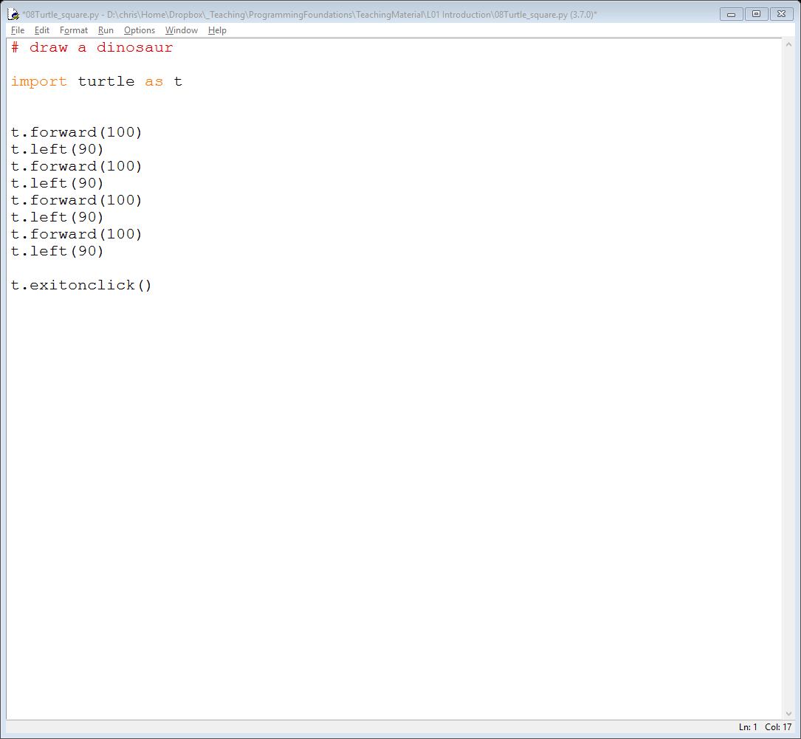
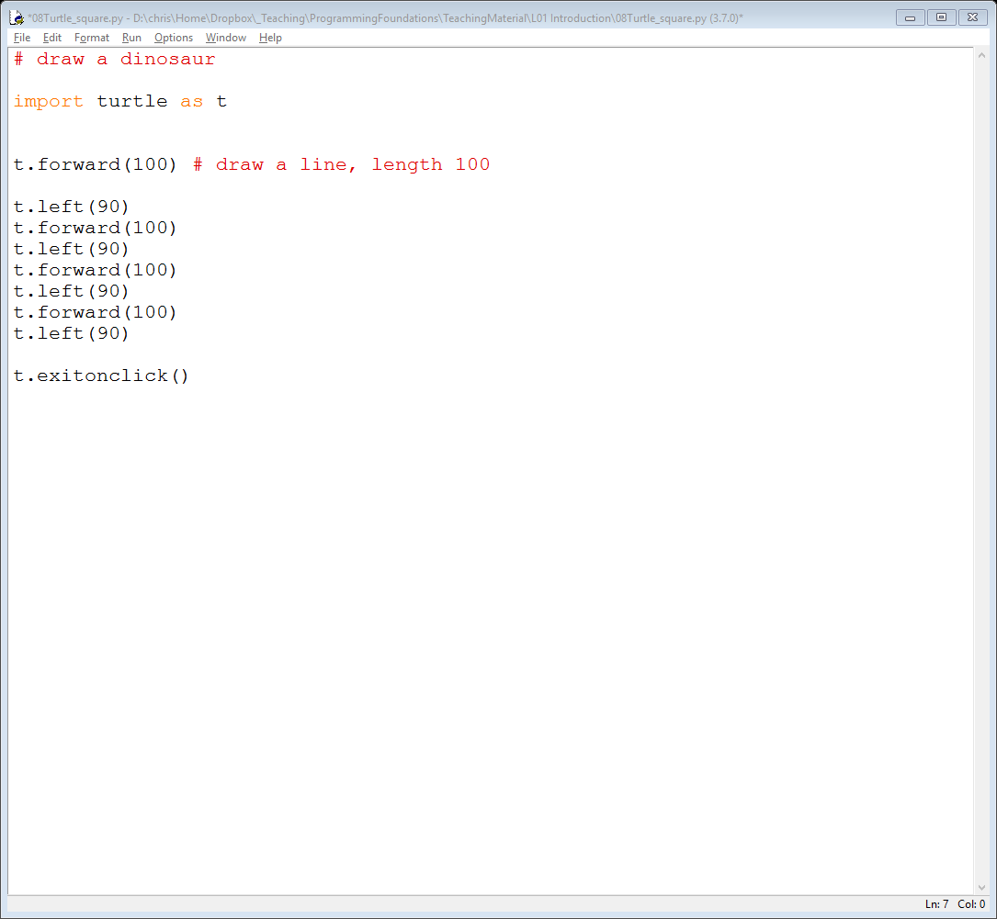
Comments
The first line is a comment
it has no effect on how the code works
So you can change it to whatever you want
but you will still get a square (unless you change the rest of the code)
Comments can also be put at the end of a line of code
Python ignores everything from the # to the end of the line

Slide 32
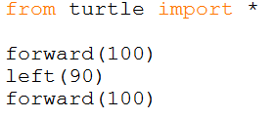
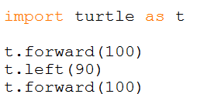
Importing Turtle
Did you notice the “t.” as in “t.forward(100)”?
there are different ways to import/use Turtle
The Turtle Demos use syntax like
The lecture examples (in the download) use
Both do more or less the same thing
but the “t.” helps to remind us that the commands come from Turtle

Slide 33
Pen up / down
If you want to move to another location without creating a line, just lift the pen up and then put it down when you want to start drawing again, e.g.
t.penup()
t.forward(100)
t.pendown()
We can now create a square with no top
see 09Turtle_squareNoTop.py

Slide 34
More commands
Or, can move directly to a location, e.g.
t.goto(100, 200) – move to the location x = 100, y = 200 (where x = 0, y = 0 is the centre of the screen)
Can fill the area inside the lines you have drawn, e.g.
t.fillcolor("red")
t.begin_fill()
…
t.end_fill()
And that’s enough to draw a bow tie shape
see 10Turtle_bowtie

Slide 35
Summary
We have looked at quite a lot so far …
What is programming?
languages / syntax / problems
What is Python?
installing / IDLE / shell
Using the Python shell
First programs
Hello World!
other examples
Turtle graphics
getting started
simple shapes

Slide 36
… but the most important things to remember are …
Program, program, program
Backup, backup, backup!!!
Above all develop a curiosity about how programs work and an eagerness to mess around with them

